Slide 1
Pine Hill Cemetery
1730 Rush Scottsville Road
Rush, New York 14543
Cemetery Association founded 1863

Slide 2
The Old Section
A tour of the historical monuments in the
Old Section of Pine Hill Cemetery
Monuments of several of the founding families of Rush

Slide 3
Founding Members of the Pine Hill Cemetery Association
Warren Foote
Thomas J. Jeffords
John Lyday
Peter Martin
Matthew C. Martin
Socrates Smith

Slide 4
Family Plot of Warren Foote

Slide 5
Family Plot of Thomas J. Jeffords

Slide 6
Family Plot of John Lyday

Slide 7
Family Plot of Peter Martin

Slide 8
Family Plot of Matthew C. Martin

Slide 9
Family Plot of Nathan Jeffords

Slide 10
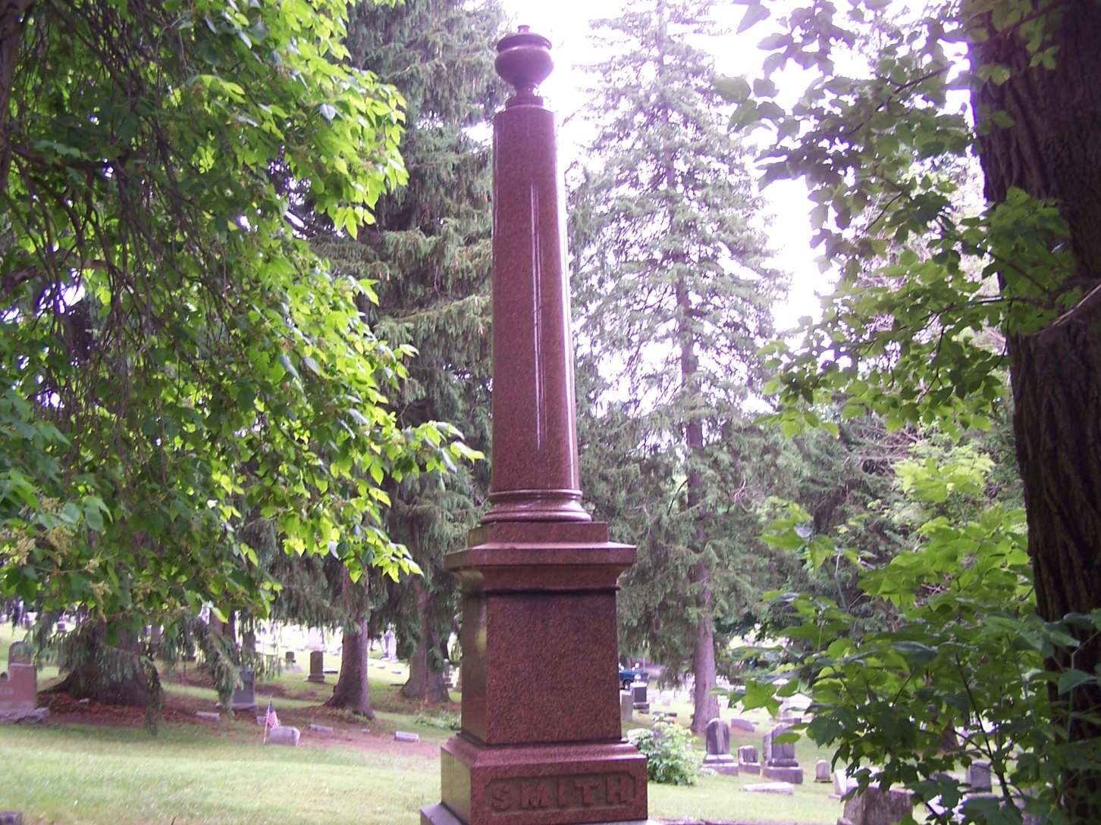
Family Plot of Dr. Socrates Smith

Slide 11
Dr. Socrates Smith
Oct. 21, 1801 – Aug. 27, 1870
Old Section, Row E, Lot 5 – at the top of the hill.
Founding member of the Pine Hill Cemetery Association
Born in Vermont , graduated from Castleton Medical College
Married to Matilda Markham Smith, 1805-1903, daughter of Col. William Markham, Revolutionary War Soldier.
Mrs. Smith affiliated with DAR (Daughters of American Revolution)

Slide 12
Blood Family Plot
Old Section C 15 and C16

Slide 13
Dennis/Greene Family Plot
Old Section H 1 and I1

Slide 14
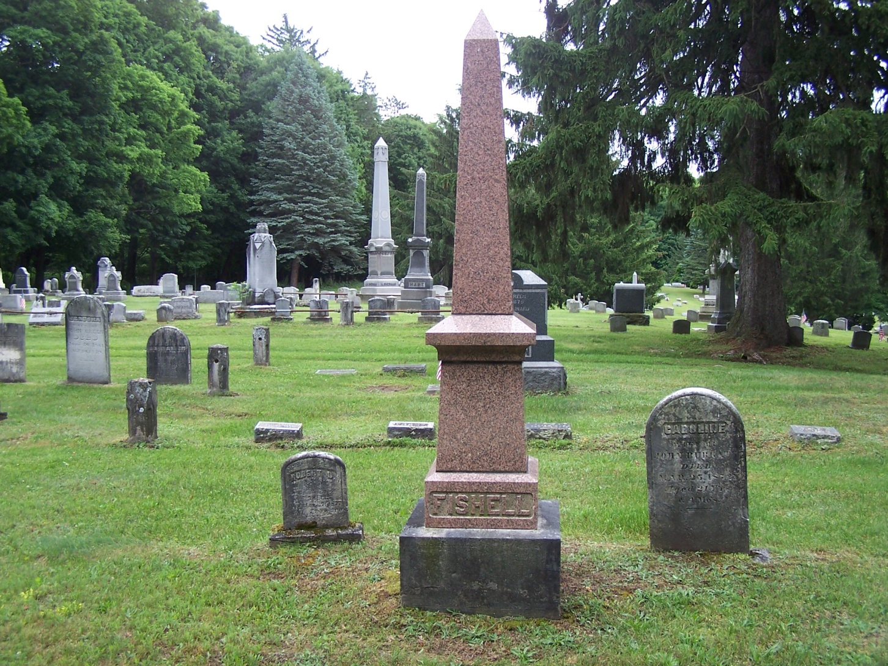
Fishell Family Plot

Slide 15
Phelps Family Plot

Slide 16
Price Family Plot

Slide 17
Sherman Family Plot

Slide 18
Stull Family Plot

